Slide 1
Multi-variate Linear Regression
Deep-Learning Seminar ch.9

Slide 2
Contents
1. Multi-variate Linear Regression
2. Loss Functions

Slide 3
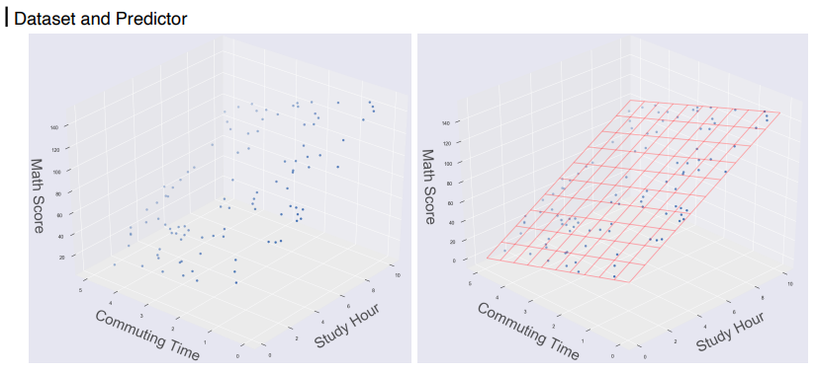
1. Multi-variate Linear Regression

Slide 4
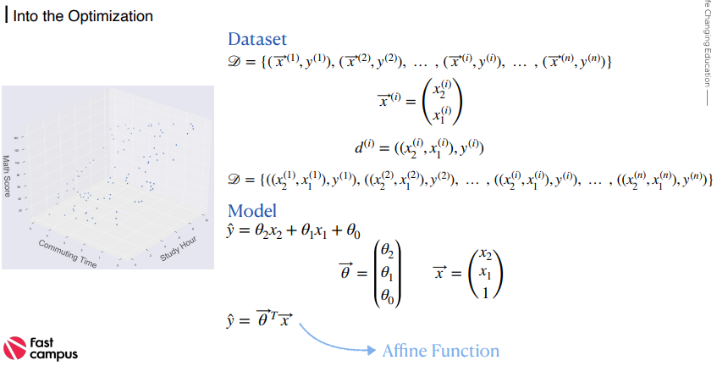
1. Multi-variate Linear Regression

Slide 5
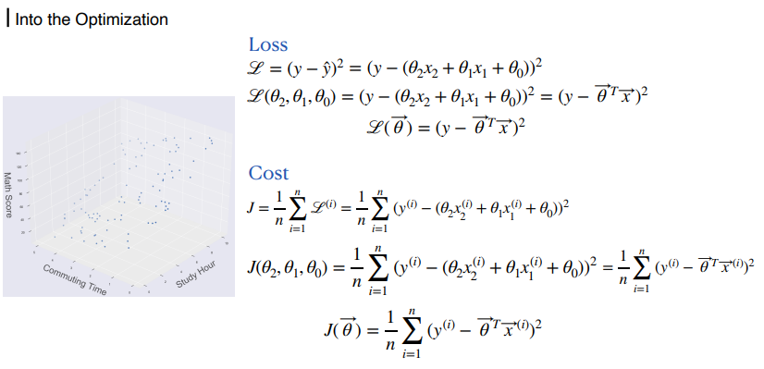
1. Multi-variate Linear Regression

Slide 6
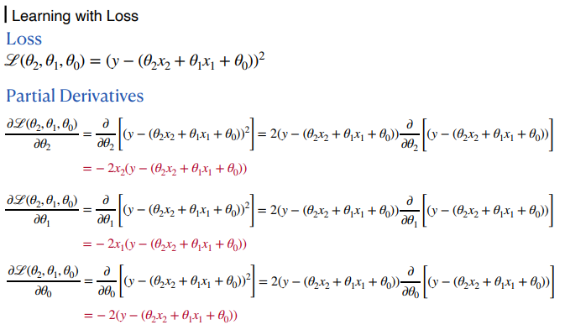
1. Multi-variate Linear Regression

Slide 7
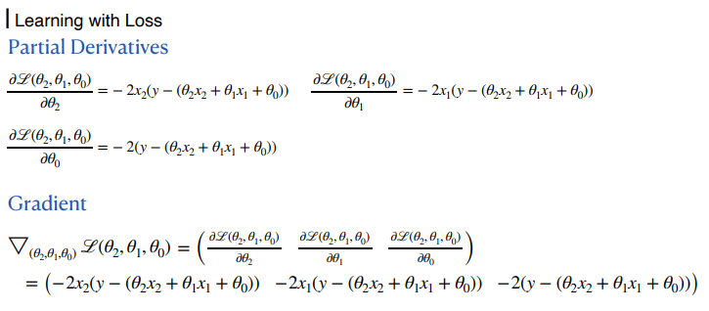
1. Multi-variate Linear Regression

Slide 8
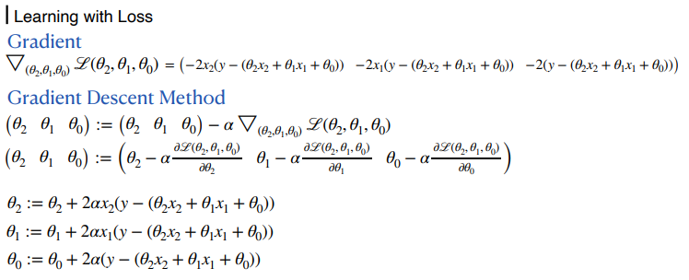
1. Multi-variate Linear Regression

Slide 9
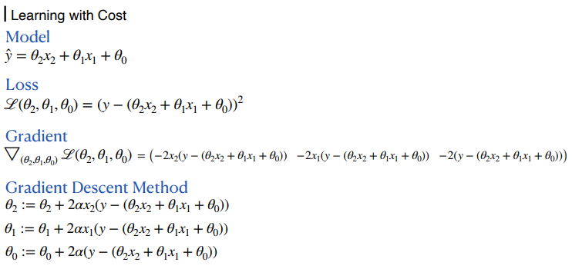
1. Multi-variate Linear Regression

Slide 10
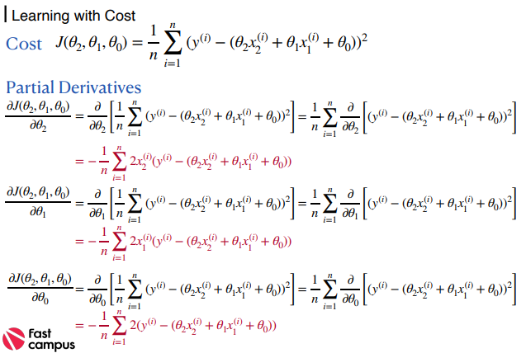
1. Multi-variate Linear Regression

Slide 11
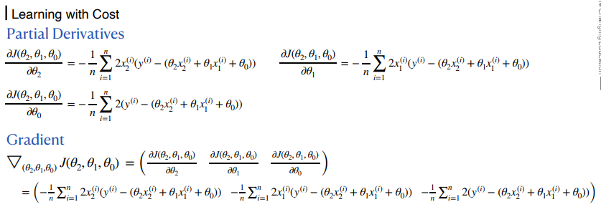
1. Multi-variate Linear Regression

Slide 12
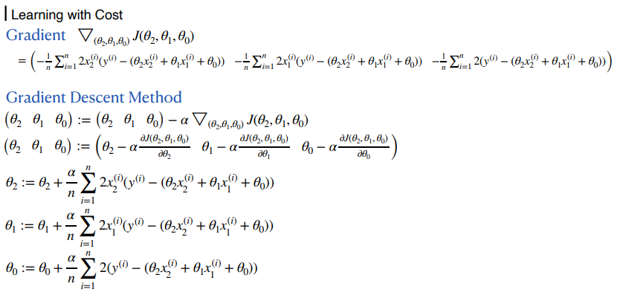
1. Multi-variate Linear Regression

Slide 13
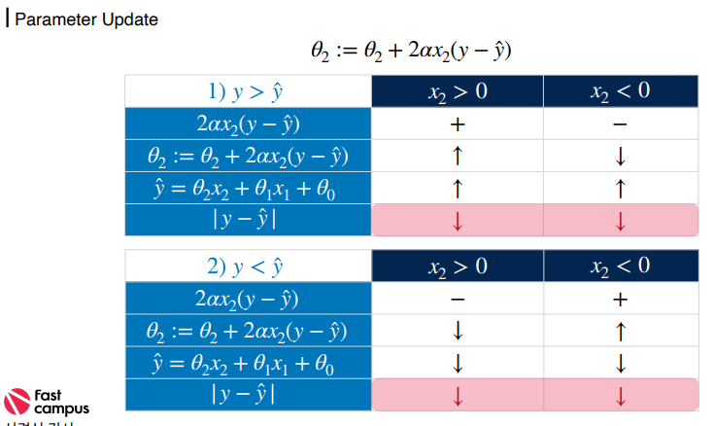
1. Multi-variate Linear Regression

Slide 14

1. Multi-variate Linear Regression

Slide 15
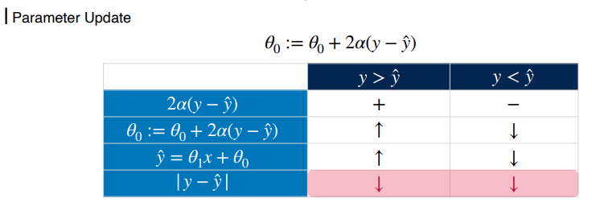
1. Multi-variate Linear Regression

Slide 16
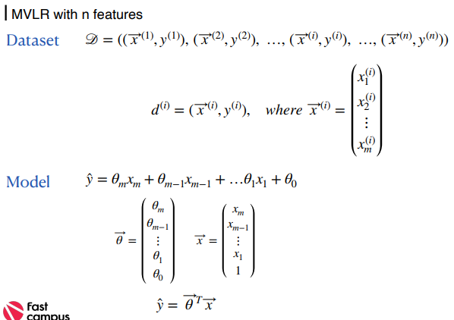
1. Multi-variate Linear Regression

Slide 17
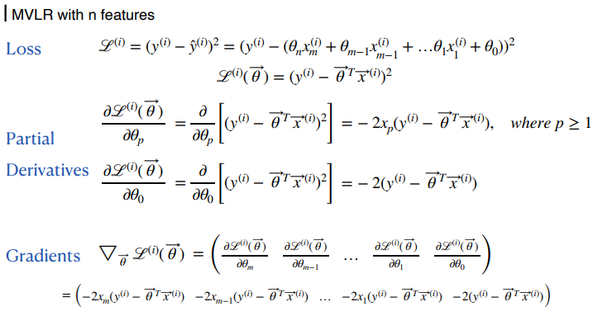
1. Multi-variate Linear Regression

Slide 18
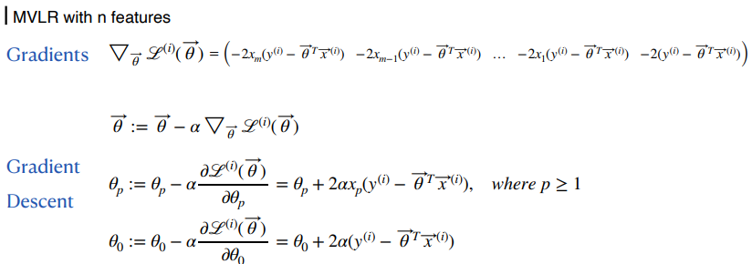
1. Multi-variate Linear Regression

Slide 19
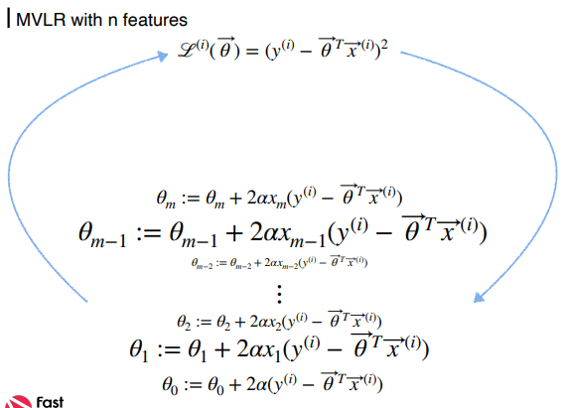
1. Multi-variate Linear Regression

Slide 20
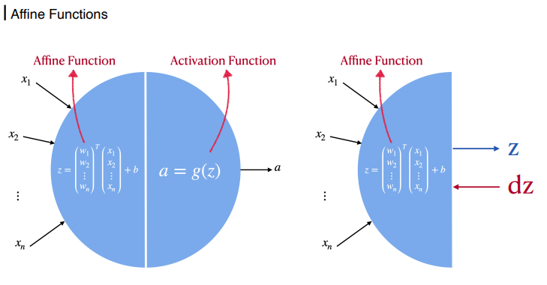
1. Multi-variate Linear Regression

Slide 21
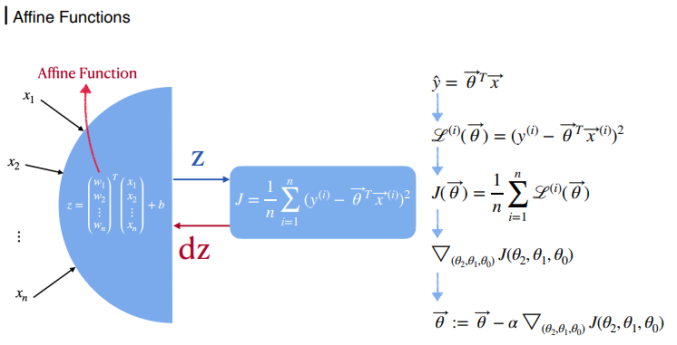
1. Multi-variate Linear Regression

Slide 22
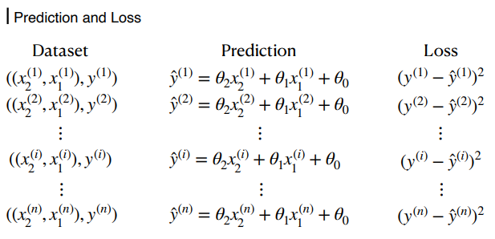
2. Loss Functions

Slide 23
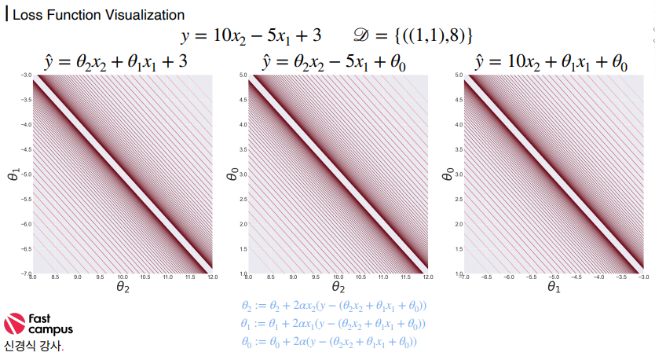
2. Loss Functions

Slide 24
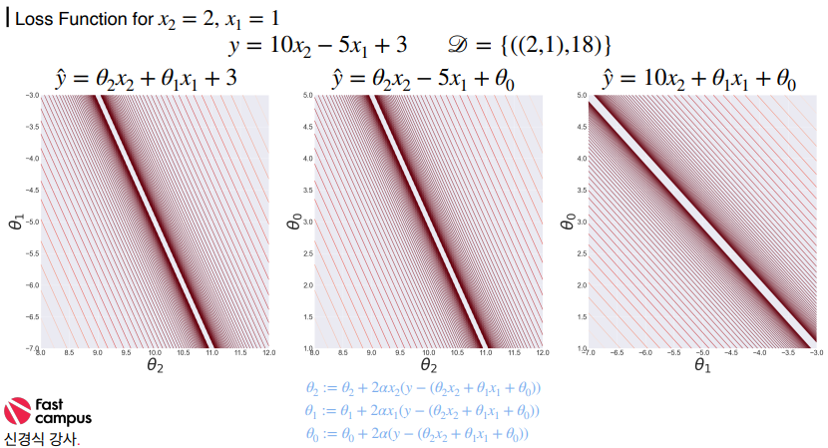
2. Loss Functions

Slide 25
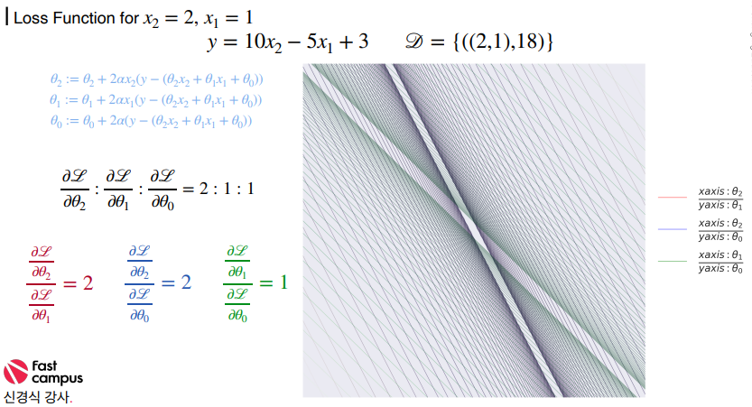
2. Loss Functions

Slide 26
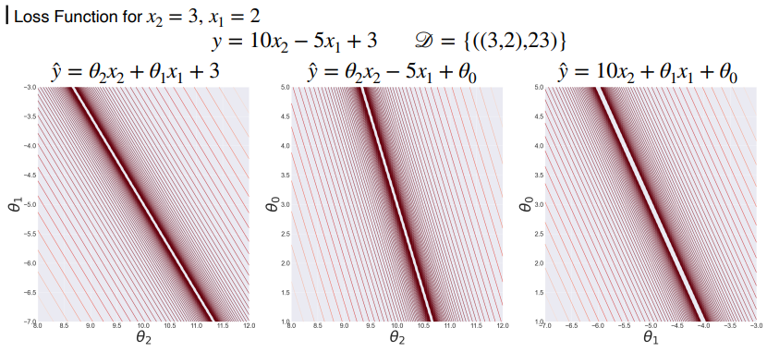
2. Loss Functions

Slide 27
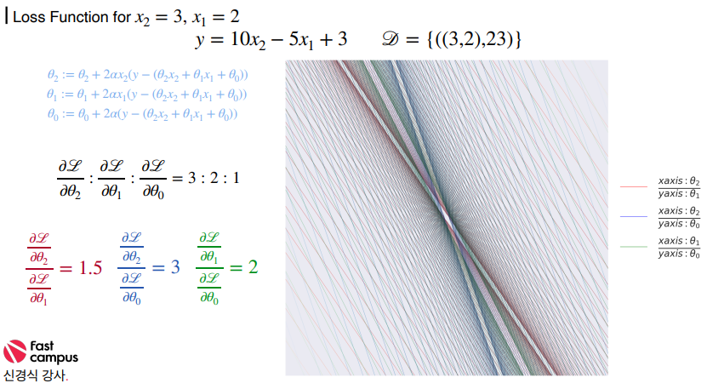
2. Loss Functions

Slide 28
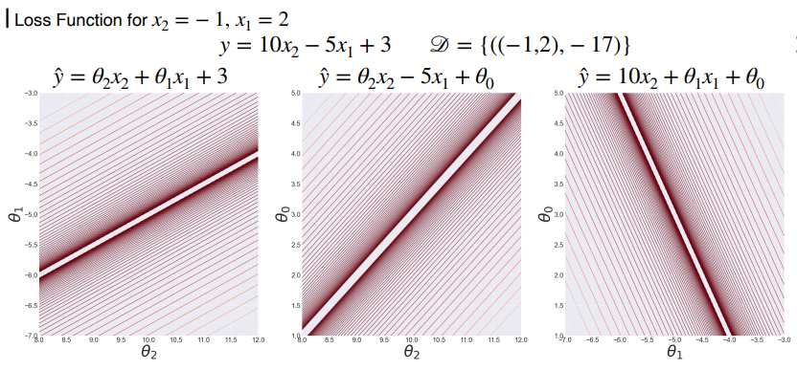
2. Loss Functions

Slide 29
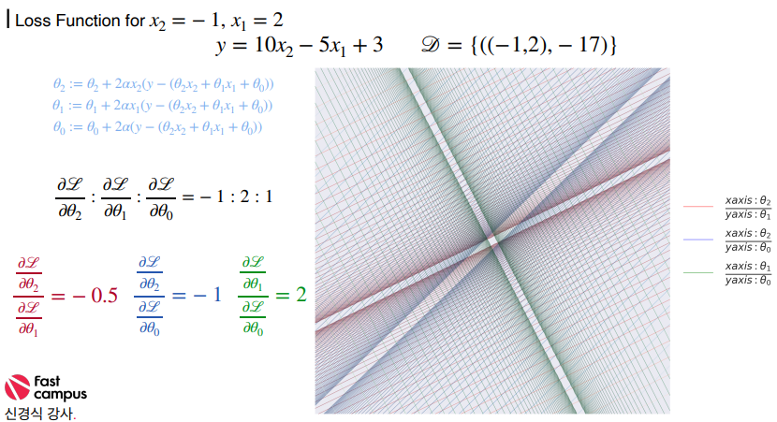
2. Loss Functions

Slide 30
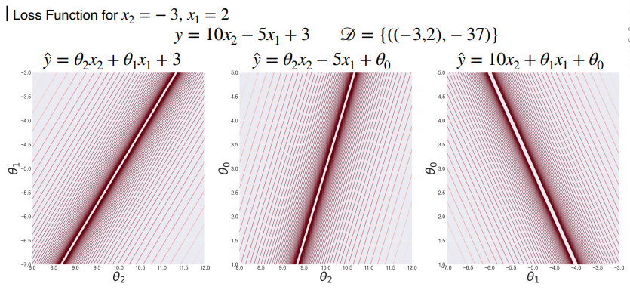
2. Loss Functions

Slide 31
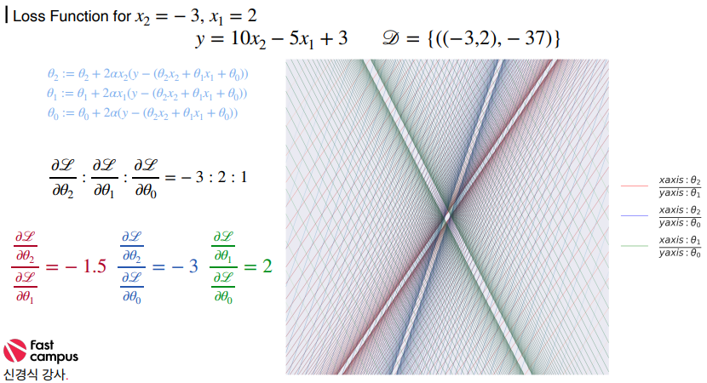
2. Loss Functions

Slide 32
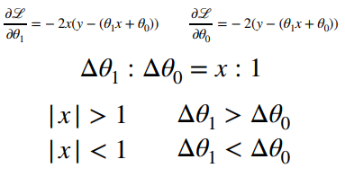
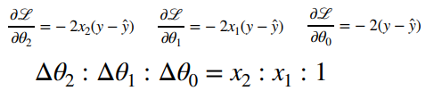
2. Loss Functions

Slide 33
감사합니다

